Slide 1

Kabai Moipone 215203569 Msomi Sebe 216028604
Assignment 3
The Tourism System’s Pecha Kucha
Due Date: 16 September 2020

Slide 2
Change Process
We use process analysis to understand what is going on in our process. We assessed our current system, practice weaknesses and identified bottlenecks. We will be looking for information about the process’s problem and inefficiencies. The process models will describe the process that may be developed, and it will focus on process characteristics such as speed and robustness.
We have identified key characteristics to remain successful and profitable during level 3 lockdown. We will need to use one of the process analysis techniques to improve our tourism system. The most common technique is questionnaires and interviews to for information purposes for the next person who comes to the development team who doesn’t know anything about the system.

Slide 3
Change Process continues…
We use process analysis to understand what is going on in our process. We will be looking for information about the process’s problem and inefficiencies.
We have identified key characteristics to remain successful and profitable during level 3 lockdown. We used process analysis techniques to improve our tourism system. The process analysis will help us to understand the activities involved in the process and the relationship between these activities and understand the Tourspace system process activities and the measurements that we will make.

Slide 4
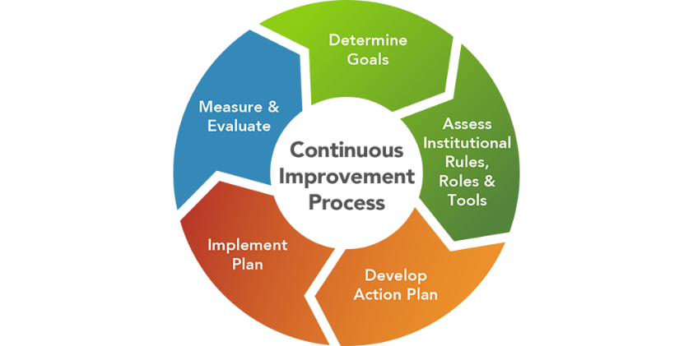
Change Process continues…
We choose to use questionnaires to discover the extent of which good software engineering practices are used. We used process analysis to understand the activities involved in the process and the relationship between these activities in understanding the Tourspace system process activities and the measurements that have been made.

Slide 5
Change Process continues…
Improvement identification – We will use the results of the process analysis to identify ways to challenge quality problems such as travel restrictions, accommodation bookings are not allowed, and restaurants are closed. Cost inefficiencies that we have identified during tourism system analysis. We propose to implement new processes, process structures, methods and tools to address the problems we outlined. We will write these new changes using best practice guide. We will redefine our requirements of the Tourspace system to include the new changes.
We will propose new methods that allow our tourism system to display all accommodations and restaurants that are open for domestic traveling and operating during level 3 and create methods that increase revenue.

Slide 6
Change Process continues…
Process change introduction – We will implement the methods that we have proposed during the improvement identification stage and we will integrate these methods with other activities and ensure compatibility between these process activities. We will set enough time to introduce the changes and to ensure our system is compatible with other process activities, procedures and standards. The Tourspace will acquire tools for requirements management and designing processes to use these tools.
Process training – As developers that have been involve during the implementation of the Tourspace system, it will not be a challenge to fit in and understand these new proposed changes and how to implement them.
The training that we will be required would be when new tools that will be introduced. In the training session, we will have discussions of the value of requirements management, explain the process activities and introduce the tools that have been selected.

Slide 7
Change Process continues…
Change tuning – We will perform a test on our system to discover minor problems. After discovering these problems. The process changes will never be effective as soon as they are introduced. Introducing too many changes makes it impossible to assess the effect of each change on the process. We will propose and introduce modifications to the process and if we are happy with the process, the changes will be completely operative.
We will make this phase to last for few months to discover defects and to make sure all the changes have been made successfully and the system is going to production.

Slide 8
Change Process continues…
Improvement prioritization – We will assess all the possible changes on our system and prioritize them for implementation. We will prioritize the changes based on criticality. We will start with the high, then medium and lastly low priority changes to avoid introducing all the changes at once. We will not make too many changes at once but we will consider introducing requirements management processes to manage evolving requirement to the highest process change.
We will decide on the process areas that need improvement, how much to introduce these changes and their impact on our system.

Slide 9
Change Process continues…
We will implement these changes by developing a communication strategy that include a timeline for how the change will be incrementally communicated and how will the change be communicated. Provide effective training to teach the skills and knowledge required to operate efficiently. We will introduce new practices, methods and tools as well as new roles or responsibilities. Measure the change process to ensure that we have achieved our goal which is to reduce the number of defects discovered during integration testing. We will use the process measurements to assess the effectiveness of the changes on our system.

Slide 10
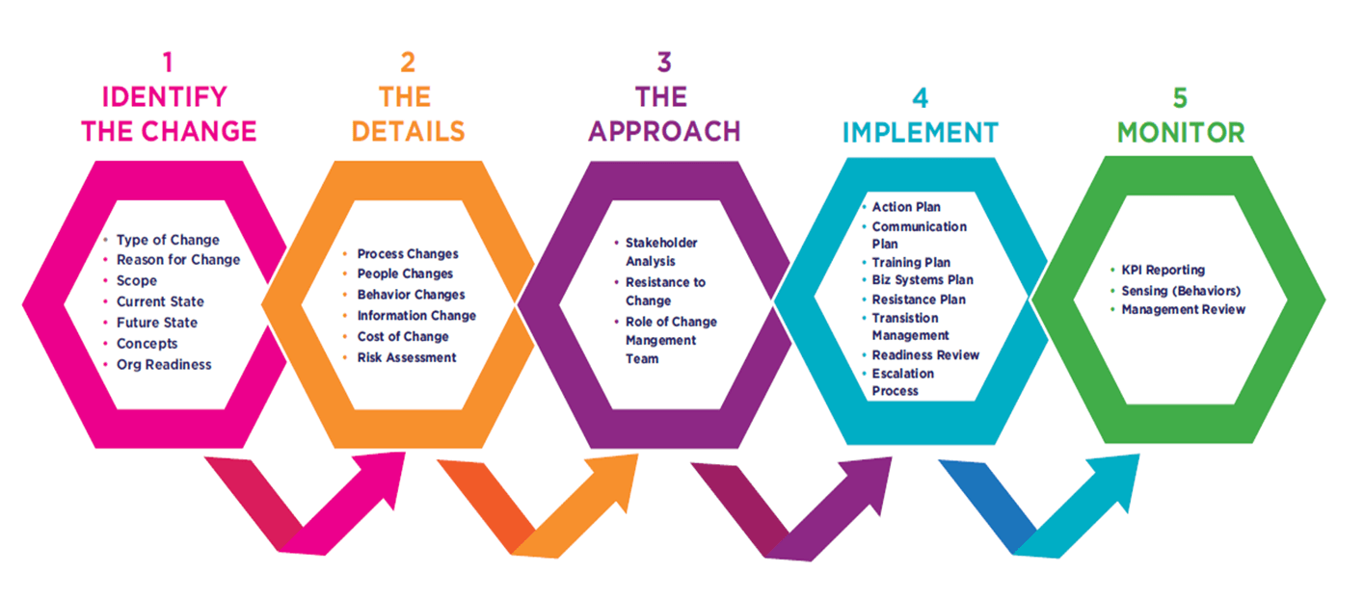
Change Process continues…
.

Slide 11
Lehman’s first Law
Lehman’s first law states that system maintenance is an inevitable process. As the system’s environment changes, new requirements emerge and the system must be modified.
In South Africa, level 3 requirements of the lockdown didn’t allow people to travel all around the world, which was an environmental factor. During that time our system, Tourspace, would have had to change in order to be compliant with the new business regulations. We would have to grey out the buttons for “Safest Accommodations” and “Activities” because hotels and most activities were not permitted during this time. The only thing people could do is to access restaurants to order to collect/be delivered to them, but not dining-in.

Slide 12
Lehman’s first Law continues…
Currently in level 2 of the lockdown, the new regulation is to allow guests to dine-in restaurants, opening of hotels, B&Bs or any other accommodation premises, as well as some activities being allowed like opening of cinemas. All these are allowed still under strict precaution measures of social distancing, and travelling to other countries is still prohibited. This is another environmental change which will result in a change adjustment to the Tourspace system according to Lehman.
People are now allowed to reserve spaces to dine-in restaurants, which our system will have to change to allow users to be directed to the relevant pages of restaurants they prefer. Tourspace will allow users to access the “Safest Accommodations” and “Thrilling Activities” buttons as they would have been greyed out due unavailability of services in compliance to the business regulations of the previous level of lockdown.

Slide 13
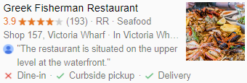

Lehman’s first Law continues…
In the upcoming level one of the lockdown, the new business regulations to comply with will be introduced, and according to the given environmental requirements for business operation, our system will have to change to accommodate the new required changes in order for it to stay useful to the end-user’s by fulfilling their needs.

Slide 14
Lehman’s fifth Law
Lehman’s fifth law is concerned with the change increments in each system release. Adding new functionality to a system inevitably introduces new system faults. The more functionality added in each release, the more faults there will be.
Because of the lockdown regulations set forth for businesses to comply with, our Tourism system will have to change functionality in increments to accommodate the new ways that the business regulations requires each time lockdown levels are lifted. So in order for our system to remain useful to the end-user, these incremental changes to the system are required each time a new legislation is introduced in a lockdown level, which will bring errors to the system. These errors could include failure of the system that was already functional in the level prior to the one that requires a change increment.

Slide 15
Lehman’s fifth Law continues…
For example, when level 2 was introduced during level 3 of the lockdown, all the new requirements based on the legislation accompanying level 2 were supposed to be implemented in the tourism system such as allowing tourists to book hotels, and restaurants to dine-in. This had to be implemented so that the system stays compliant with the new level of lockdown. Changing the system from what it provided in level 3 to what it should now provide in compliance to level 2 regulations could cause so many errors such as causing the system to perhaps fail in the validation process of checking the login credential of a user before accessing the system.

Slide 16
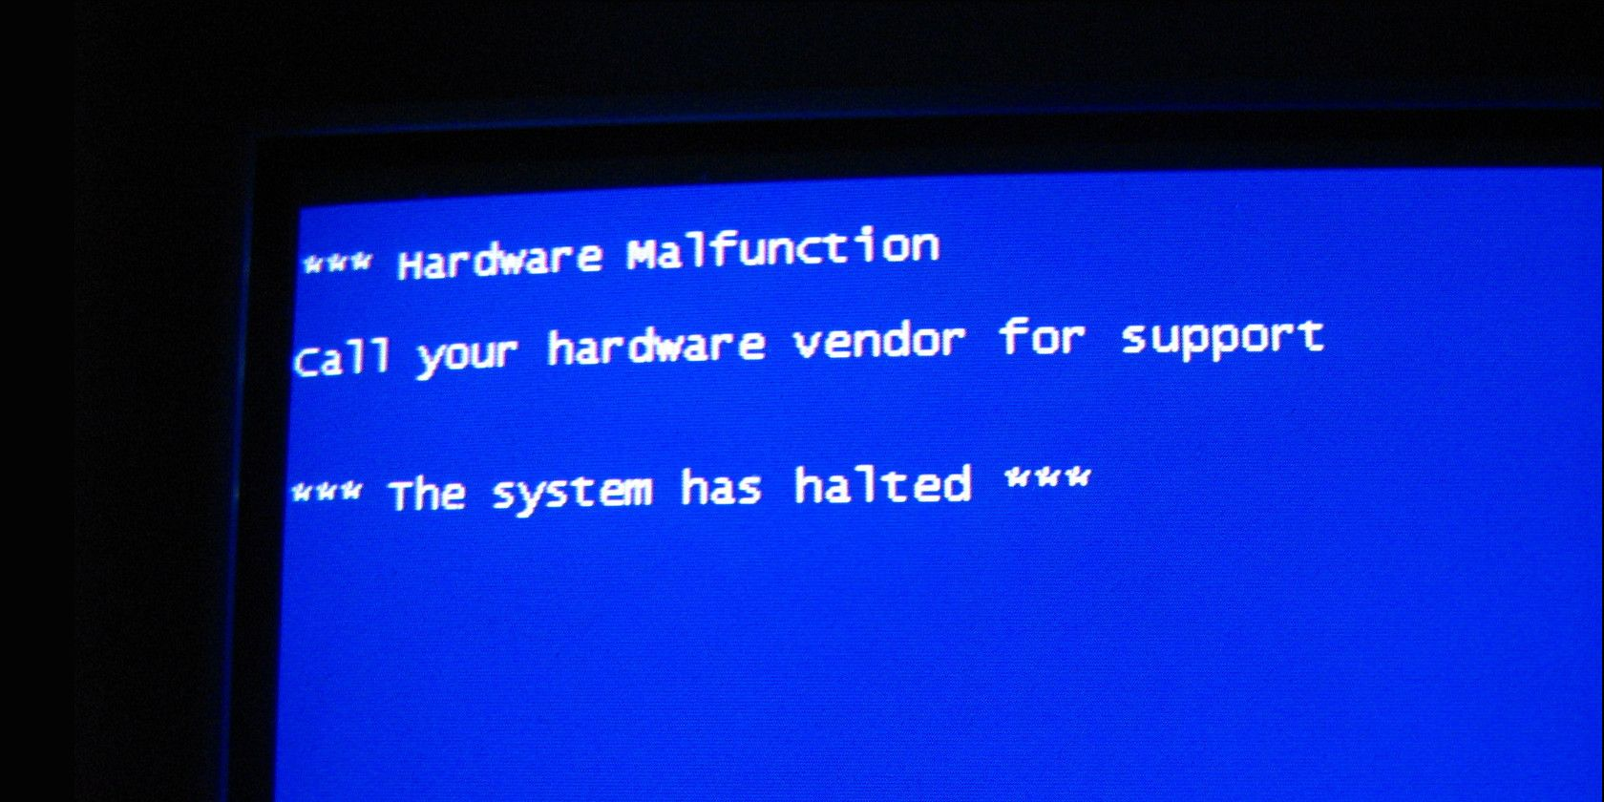
Lehman’s fifth Law continues…
The system could crash, resulting to another system being focused on in addition to the incremental change currently being implemented.

Slide 17
Lehman’s sixth Law
The sixth law basically says that users of software will become increasingly unhappy with it unless it is maintained and new functionality is added to it.
With regards to level 3 lockdown regulations, our system will have to be maintained every time a new business requirement is introduced so that we will be compliant to the regulations by introducing new functionality that will be suitable for that particular time of the level. Like in level 3, there won’t be any hard functionality the system will provide to the user, there will only be bare minimum functions such as ordering food from restaurants, only as takeaways, not for dining in.

Slide 18
Lehman’s sixth Law continues…
For compliance, every time a new level is introduced the system will have to adapt to the new change requirements so that the system users will stay satisfied with our services, and not find Tourspace not useful to their needs or demands.
This will be quite a critical process to change system functionalities incrementally until all the required deliverables are met. In level 3 of the lockdown, this might or will not be an issue at all introducing a simple system that does not require too much functionality, but as the lockdown levels keep being lifted, we will have to adjust to more and more advanced increments that will put the system in jeopardy of crashing, or at least introducing errors that will affect the current functionality. But at last, all requirements will be met to satisfy the end user of the system.

Slide 19
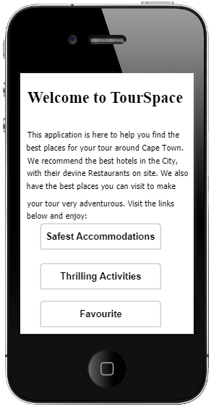
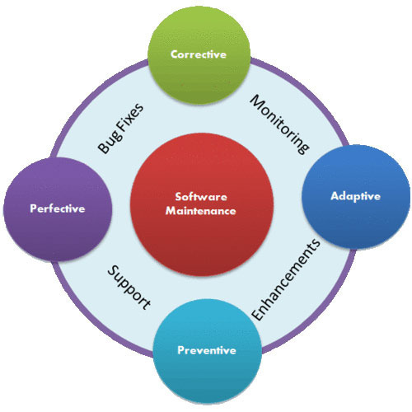

Lehman’s sixth Law continues…
Tourspace should be maintained to keep system users happy.

Slide 20

The End…

